Slide 1
Science and Research Branch (SRB)
Forest Resources Inventory Unit (FRIU)
Tableau Public introduction and using the hidden function to control access
Peitao Xu
May 19, 2026

Slide 2
Tableau Public dashboard for T2 communication
Purpose of this deck
To outline the security and control of Tableau Public as a communication and delivery tool
Approved audience
Sustain Forest Licensee (SFL) and the Ministry (Regional Operations Division – ROD)
Benefits of Tableau reporting
Acts a shared reference throughout T2 – check point 3 discussions and final inventory steps
Single sourced, modernized and detailed data visualizations of Forest Management Unit (FMU)
Visualizations transform complex data to make the information digestible (e.g., maps, tables, charts)
Reduces lengthy written explanations and allows for quicker identification of trends and outliers
No special permissions or application downloads required for partners to view the dashboards
Improved transparency, accountability and input for and by all partners
Tableau Public is the software platform; access to content can be limited (not searchable) by requiring a link

Slide 3







Overview Tableau products
Data
preparation
Dashboard
development
Three ways to
share and read the visualizations
License
requirement
Fully hosted, cloud-based analytics platform that allows users to publish, share, and collaborate on Tableau dashboards.
Access is secure and limited to the team members who have an active Tableau license.
https://www.tableau.com/products/cloud-bi
Tableau Prep
Tableau Desktop
Tableau Cloud
Need
license
Tableau Prep resides on the desktop to assist with getting the data ready for analysis.
https://www.tableau.com/products/prep
Tableau Desktop is isolated on the desktop and connects directly to the data, with drag-and-drop tools, and helps the user make data-driven decisions.
https://www.tableau.com/products/desktop
Tableau Reader
Tableau Reader is a free desktop application used to open and interact with data visualizations built in Tableau.
https://www.tableau.com/products/reader
OPS approved product on the Company Portal.
There is no access to the supporting data just the visualization products.
Local viewer
No license
and free
Tableau Public
Tableau Public is a free platform to explore, create and share data visualizations online.
https://www.tableau.com/products/public
Online viewer

Slide 4
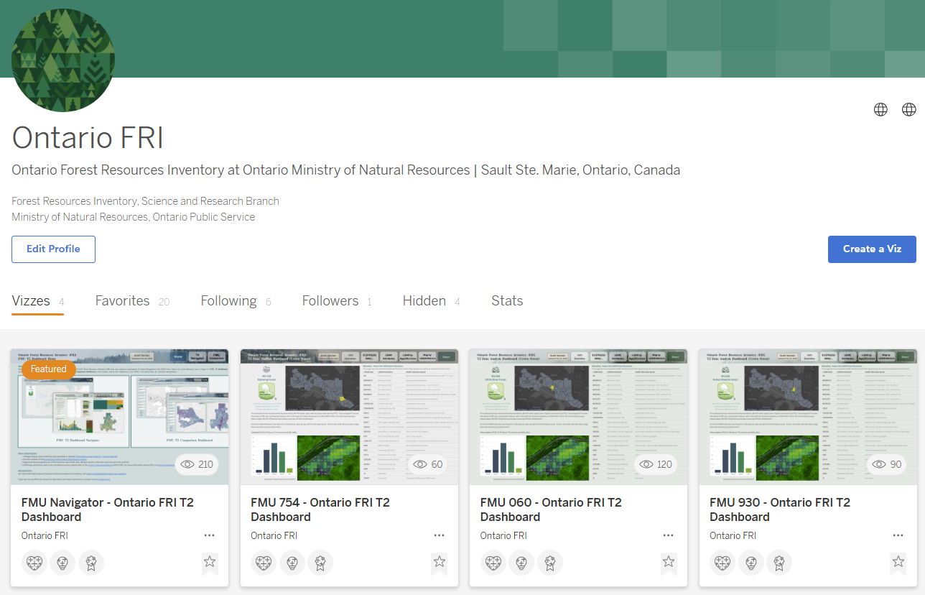
Introduction to Tableau Public
Tableau Public
Profile page:
Setting up account
Account profile
fri.tableau@ontario.ca
Editing profile here
Vizzes:
Published dashboards
Hidden:
Published visualizations, but with limited access
Only those who have the url can view those dashboards

Slide 5
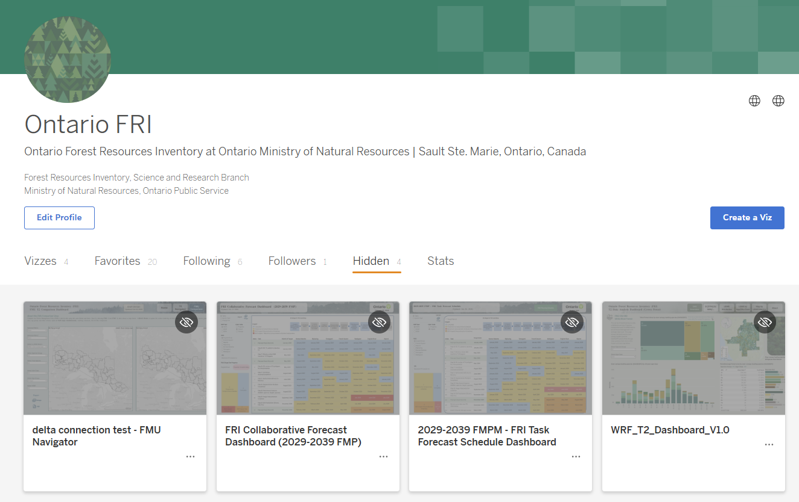
Introduction to Tableau Public
Tableau Public
Profile page:
Hidden from public for target audience
Account profile
fri.tableau@ontario.ca
Editing profile here
Vizzes:
Published Dashboards
Hidden:
Published visualizations, but access limited ─ only those with a provided link can view the dashboards

Slide 6
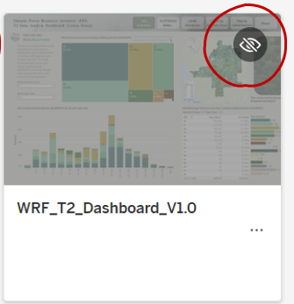
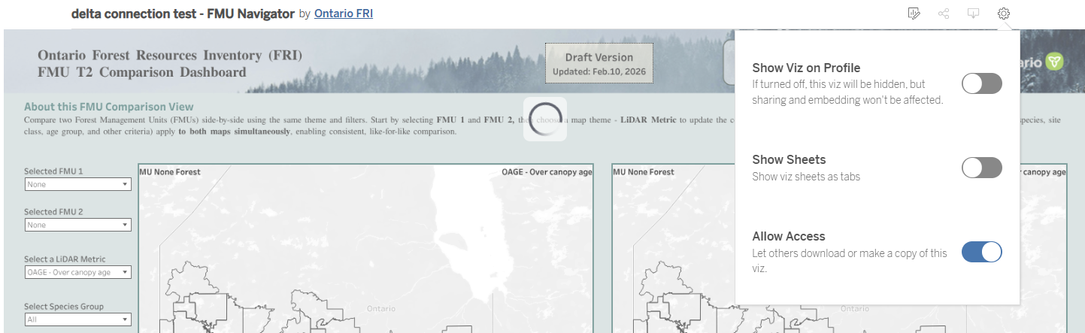
Introduction to Tableau Public
Tableau Public
Controlling viz on profile page - Turning off
  The selected dashboard visualizations will be hidden from public view on the profile page.
  The viz is only accessible by FRI provided direct link.
  Limits visibility while still sharing product through a link to the approved audience.

Slide 7

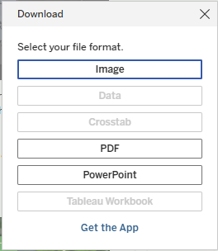
Introduction to Tableau Public
Tableau Public
Controlling access to download materials
  Turning off ─ Viewers can download the visualization only images
Turning off
FRI controls the visualization format the user may download.
The dashboard downloads will be limited to:
  Image as a PNG
  PDF
  PowerPoint
The FRI dashboard will direct all user to the FRI Partner Portal for data downloads.

Slide 8
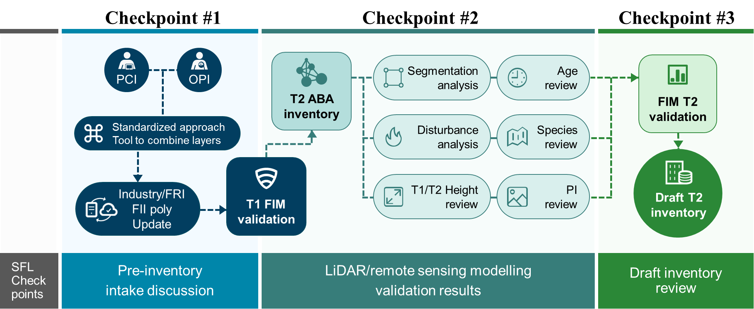
An example of using Tableau Public – T2 process

Slide 9

An example of using Tableau Public - Version control
Tableau Dashboard
Draft version 1.0 (Hidden)
Used to communicate with SFL collaborators to identify uncommon values or potential issues in the Term 2 inventory data
Draft version 1.xxx
Few iterations between V1.0 and V2.0
Draft version 2.0 (Hidden)
Shared with SFL collaborators to review all attributes and LiDAR metrics and compare results across the forest management unit
Final version (Hidden)
Used to deliver the finalized Term 2 interactive visualizations to the SFLs with direct links to the supporting dataset available through the FRI Partner Portal download
* All versions – accessible only by direct link

Slide 10

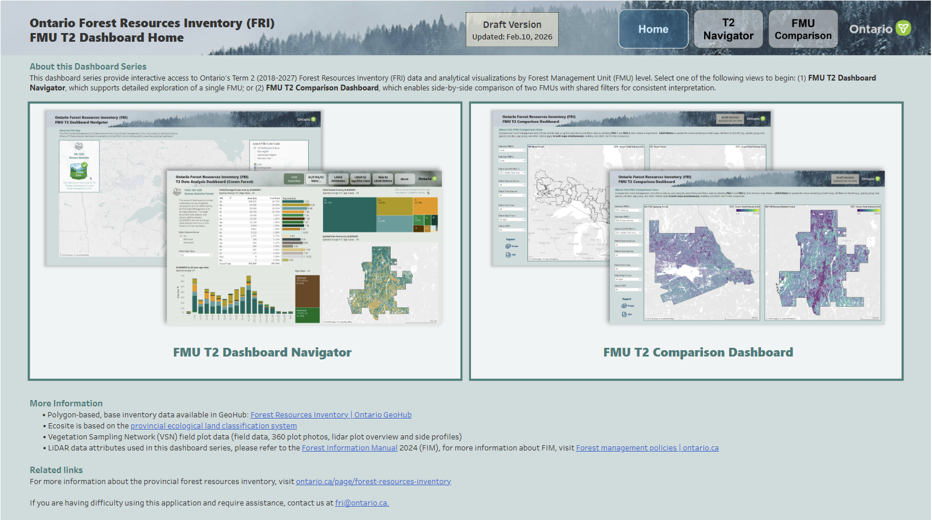
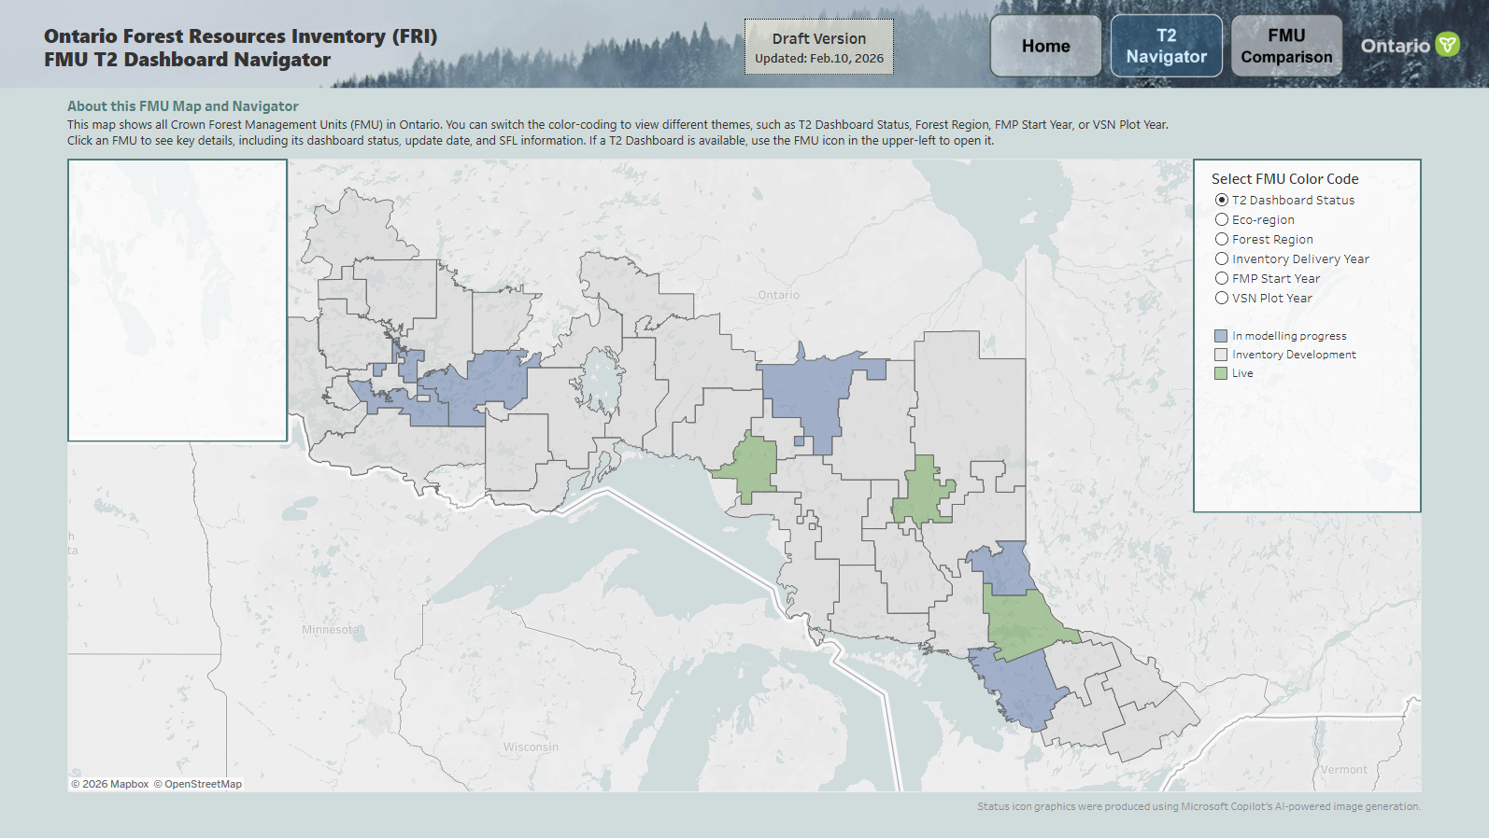
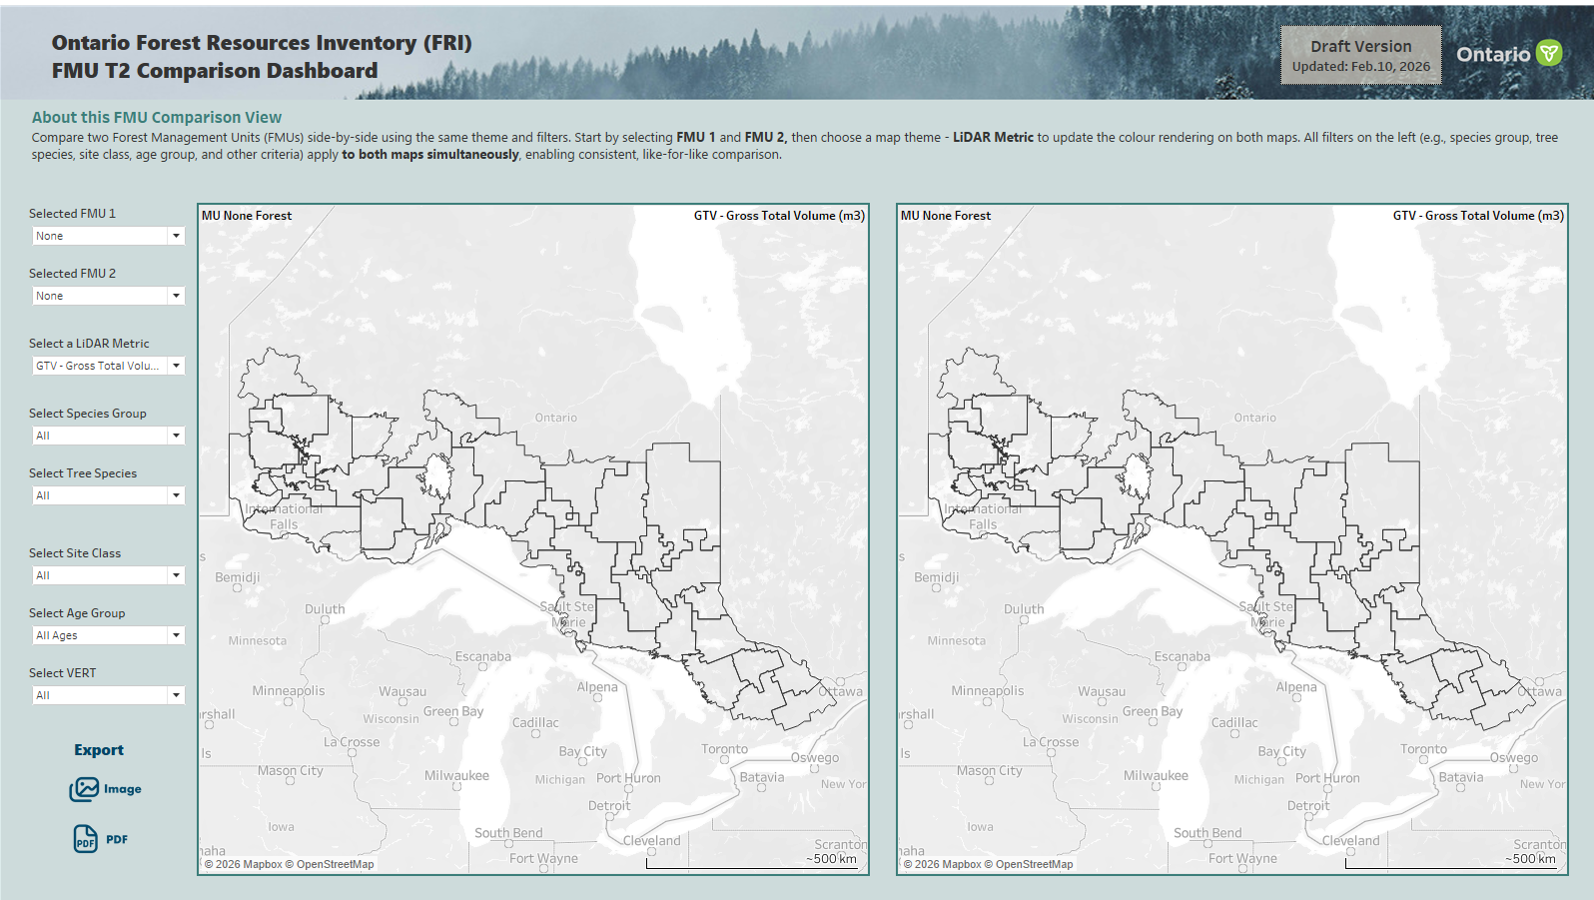
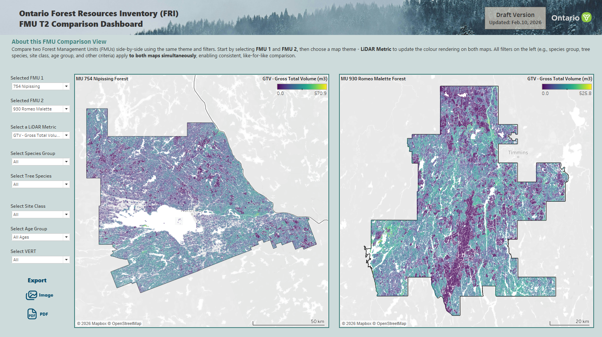
Two developed series of dashboards using
Tableau Public
0. Profile home page
1. FMU T2 Dashboard Navigator
2. FMU T2 Comparison Dashboard
1. The FMU T2 Dashboards offer interactive products for exploring valuable spatial and statistical summaries of key LiDAR attributes, such as species, height, vertical structure, gross volumes, canopy closure, and others
2. The FMU T2 Comparison dashboard aggregates LiDAR attributes across all published FMUs, enabling SFLs to compare forest conditions between forest units

Slide 11
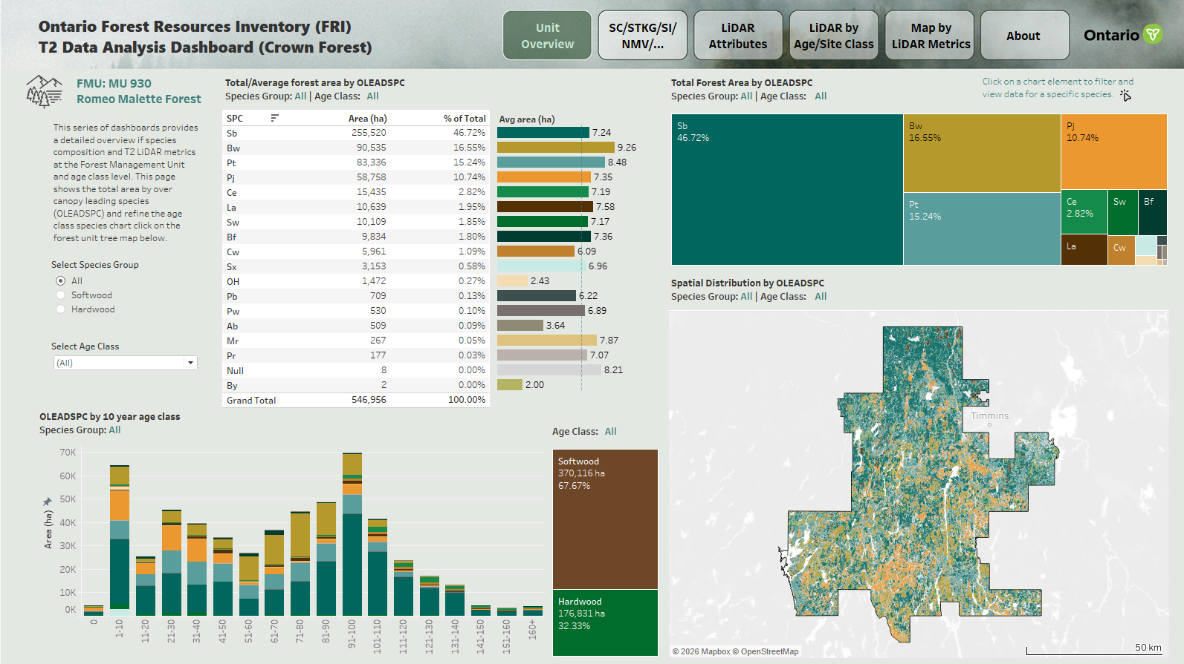
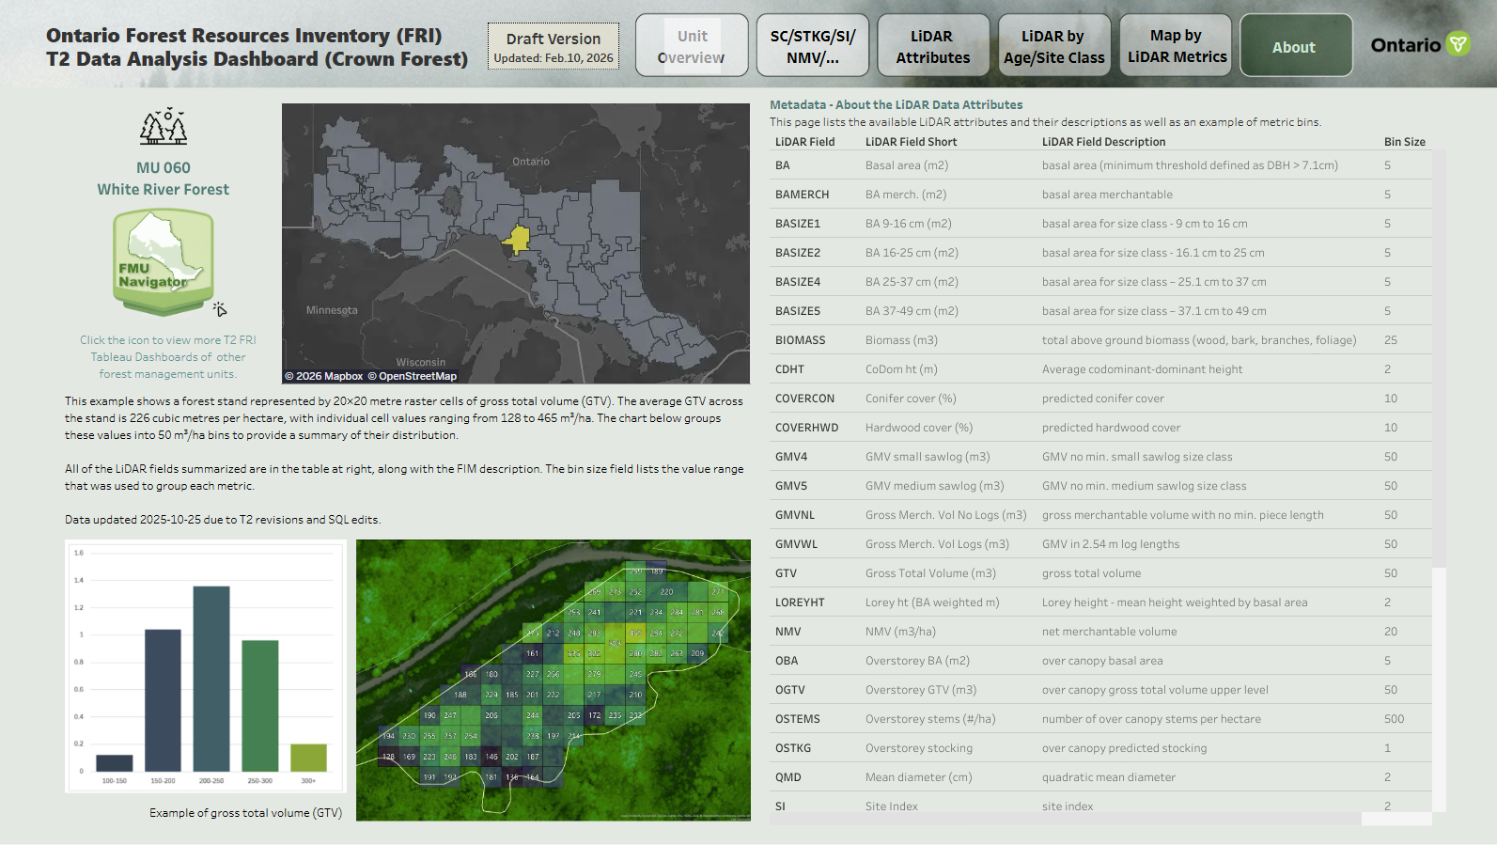
Forest management units completed FRI-T2 dashboards
1.1 FMU T2 Dashboard- Romeo-Malette
1.2 FMU T2 Dashboard- White River

Slide 12
Tableau Public introduction and using the hidden function to control access
Peitao Xu
May 19, 2026
Thanks!

